Slide 1

Exploratory Data Analysis
(AMCAT Dataset)

Slide 2
About me
Iam R.Radhika , I completed my Masters in Data science in the year 2023.
To acquire more knowledge in coding,projects I joined in Innomatics
Linked in and Github urls:
https://www.linkedin.com/in/ramachandrapuram-radhika/
https://github.com/ramachandrapuram-radhika/

Slide 3
OBJECTIVE OF THE PROBLEM
This exploratory data analysis of “AMCAT DATASET” focuses on understanding various factors that might influence the level of salaries indicated in the dataset. We consider education and experience, gender, specialization, and job roles and observe how they are related in order to understand a factor that influences higher or lower levels of salaries. The critical steps which indicate the analysis involved creating a mental image of the data, establishing trends and patterns, testing many hypotheses post observations to finally build insightful results which could be used as guidelines for any decision making process that could further calibrate salary prediction models.

Slide 4
SUMMARY OF THE DATASET
There are 38 columns in dataset that are used to find the individual impacts on salary.
Out of 38 columns, there are 29 numerical columns and 9 categorical columns.
With 3998 Datapoints that make our analysis to the optimal insights with all the necessary information.

Slide 5
DATA CHECKS TO PERFORM
Check missing values, duplicated values and various different columns.
Check the datatypes and also look at the unique number of columns.
Check statistics of data set
Check various categories present in the different categorical column.
Drop unnecessary columns

Slide 6
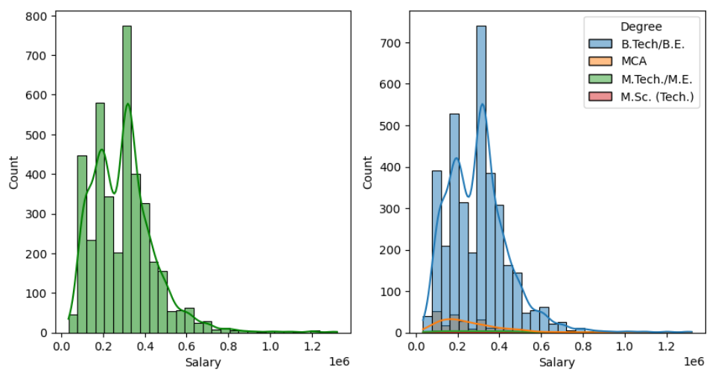
Salary vs Degree
Average salary is highest for BE/B.tech graduates as compared to any other degree graduates.

Slide 7
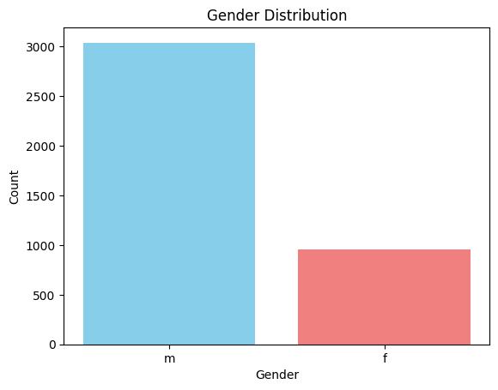
Gender Distribution
There are more number of males compared to females.

Slide 8
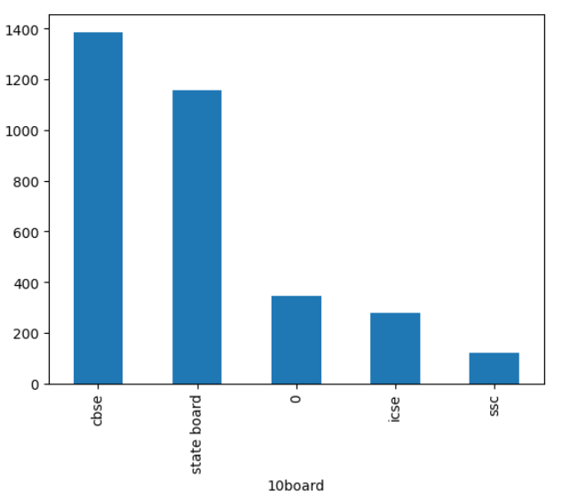
Distribution of 10board
Most of the people are from cbse
compare to cbse ,less people are from ssc

Slide 9
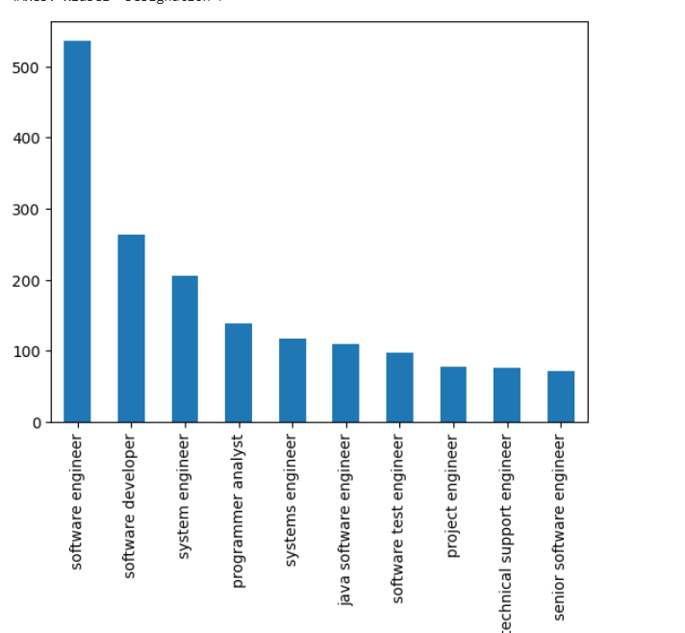
Designation Distribution
Most of people are software Developer
less people are senior software engineer

Slide 10
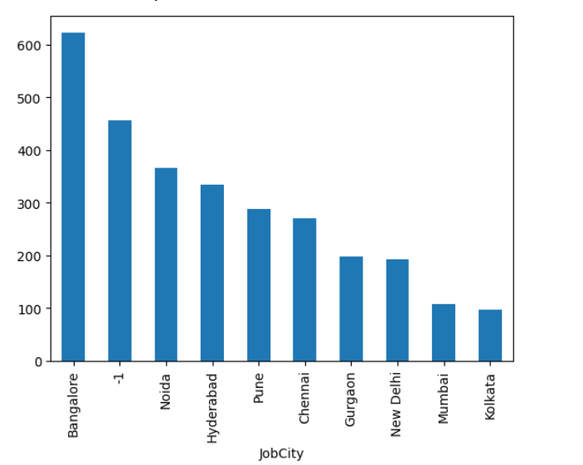
Jobcity Distribution
These are the 5 most cities which are popular Banglore,Noida,Hyderabad,Pune,Chennai

Slide 11
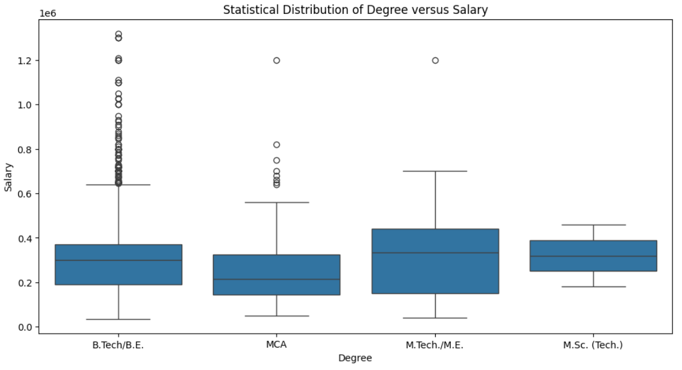
Salary vs Degree
More outliers in btech compare to other degrees

Slide 12
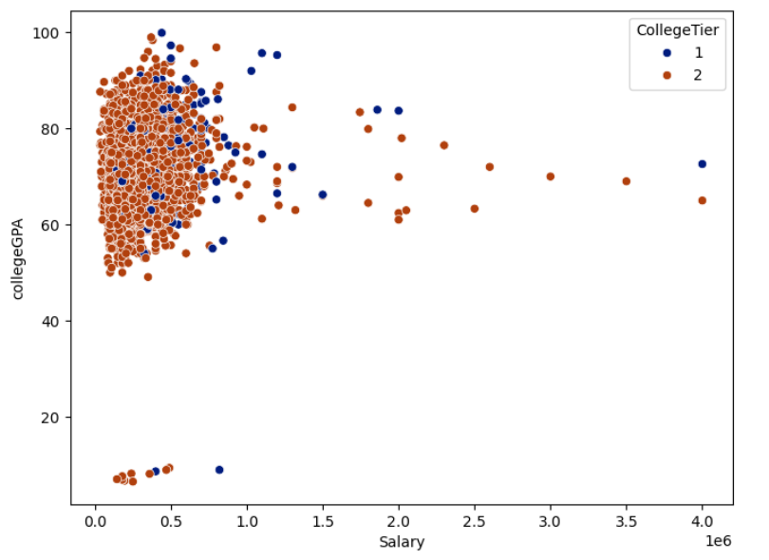
Salary vs collegeGPA
There are more outliers so we need to drop some extreme values of salary and collegeGPA.

Slide 13
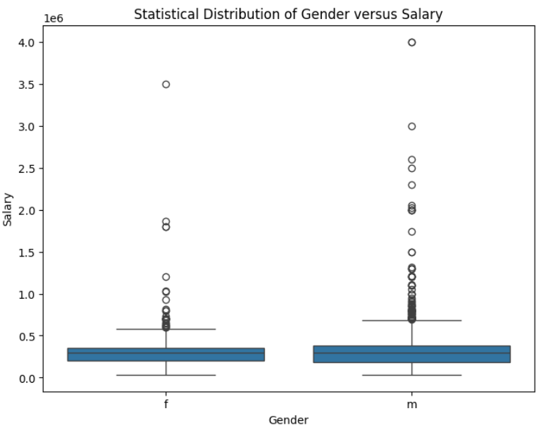
Gender vs salary
It is clearly visible from the plot that the Average salary for man and woman are looking almost same.
There are outliers in salary column.

Slide 14
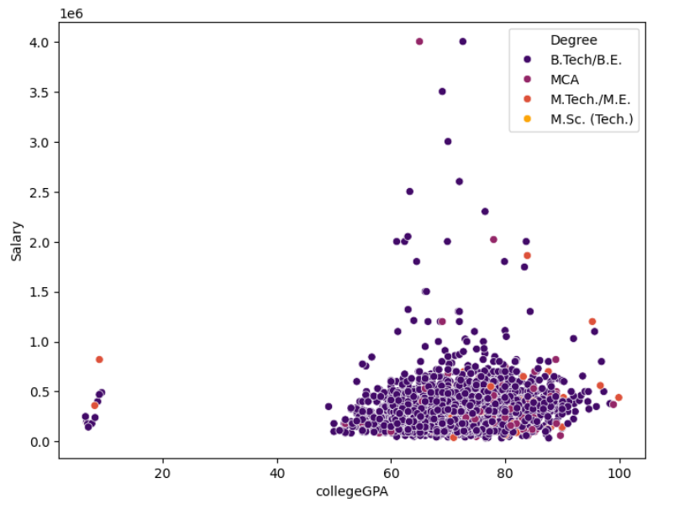
Salary vs Degree Analysis
Average salary is highest for BE/B.tech graduates as compared to any other degree graduates.

Slide 15
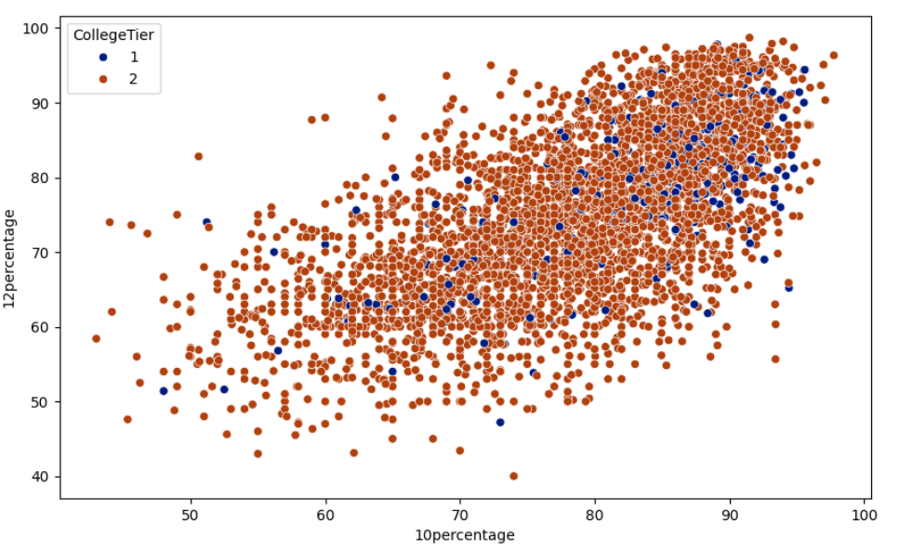
10th and 12th percentage by college tier
According to scatterplot, we can see that 10th and 12th are positively correlated, this is the case of multicollinearity so I have decided to keep only one.

Slide 16
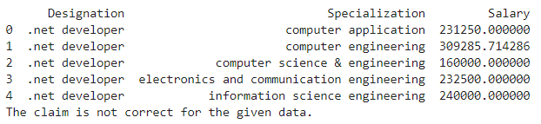
Research Question 1: Determine whether fresh graduates earn 2.5-3 lakhs annually as stated in the article.
Solution: We found that the average salary is not within the given range(i.e, 2.5 lakhs to 3 lakhs)

Slide 17
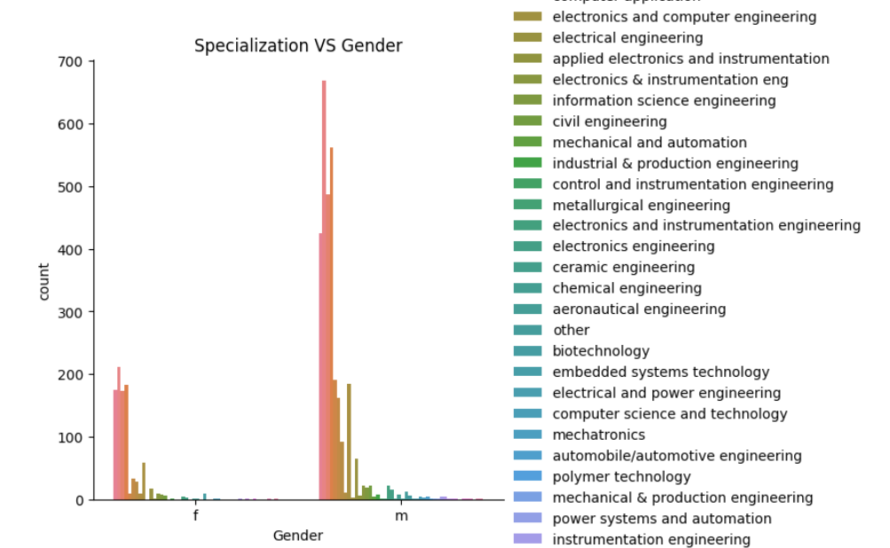
Research Question 2: Determine if gender influences the choice of specialization.

Slide 18
Insights of question 2
The most popular specializations for both males and females are Computer Science and Electronics and Telecommunications (ETRX), which make up more than 60% and 55% of their respective proportions
The proportion of females in Aeronautical Engineering, Biomedical Engineering, and Biotechnology is higher than the proportion of males in these fields.
The proportion of males in Chemical Engineering, Civil Engineering, and Mechanical Engineering is higher than the proportion of females in these fields.
Other specializations have a higher proportion of males than females.

Slide 19
Conclusion
Average salary is highest for BE/B.tech graduates as compared to any other degree graduates
The proportion of females in Aeronautical Engineering, Biomedical Engineering, and Biotechnology is higher than the proportion of males in these fields.
.The most popular specializations for both males and females are Computer Science and Electronics and Telecommunications (ETRX), which make up more than 60% and 55% of their respective proportions
These are the 5 most cities which are popular Banglore,Noida,Hyderabad,Pune,Chennai
Most of people are software Developer and less people are senior software engineer.

Slide 20

THANK YOU

